Slide 1

Physiological oxygen: from science to innovation
Krista Rantanen, PhD
Director of Scientific Applications, Baker Ruskinn
4th Physiological Oxygen and London Metallomic Facility Training Workshop

Slide 2
Wound healing
Fibrosis
Cardiovascular diseases
Diabetes
Neurodegenerative Diseases
Aging
Autoimmune disorders
Chronic infections
Gut disorders
Cardiovascular diseases
Diabetes
Aging
nfections
Gut disorders
Conditions matter

Slide 3
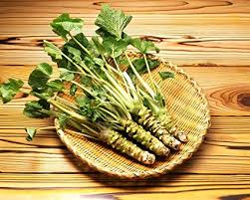
Wasabi
Notes:
Japanese horseradish, wasabi.
The wasabi plant is the diva of plants. It needs good sunlight, but it needs shade. It needs lots and lots of cold water, but not that cold. Not too hot either. Actually, just make sure it’s 13-18 degrees celsius, otherwise it’ll die. And it needs to be fresh, flowing, natural spring water. Or it’ll die. And if your wasabi plant dies, you’ve wasted one year and three months of your life — because that’s how long they take to grow.

Slide 4
Wasabi
Good sunlight; shade too
Notes:
Japanese horseradish, wasabi.
The wasabi plant is the diva of plants. It needs good sunlight, but it needs shade. It needs lots and lots of cold water, but not that cold. Not too hot either. Actually, just make sure it’s 13-18 degrees celsius, otherwise it’ll die. And it needs to be fresh, flowing, natural spring water. Or it’ll die. And if your wasabi plant dies, you’ve wasted one year and three months of your life — because that’s how long they take to grow.

Slide 5
Wasabi
Good sunlight; shade too
Lots and lots of cold water; not too cold either (13-18C)
Notes:
Japanese horseradish, wasabi.
The wasabi plant is the diva of plants. It needs good sunlight, but it needs shade. It needs lots and lots of cold water, but not that cold. Not too hot either. Actually, just make sure it’s 13-18 degrees celsius, otherwise it’ll die. And it needs to be fresh, flowing, natural spring water. Or it’ll die. And if your wasabi plant dies, you’ve wasted one year and three months of your life — because that’s how long they take to grow.

Slide 6
Wasabi
Good sunlight; shade too
Lots and lots of cold water; not too cold either (13-18C)
Fresh, flowing, natural spring water
Notes:
Japanese horseradish, wasabi.
The wasabi plant is the diva of plants. It needs good sunlight, but it needs shade. It needs lots and lots of cold water, but not that cold. Not too hot either. Actually, just make sure it’s 13-18 degrees celsius, otherwise it’ll die. And it needs to be fresh, flowing, natural spring water. Or it’ll die. And if your wasabi plant dies, you’ve wasted one year and three months of your life — because that’s how long they take to grow.

Slide 7
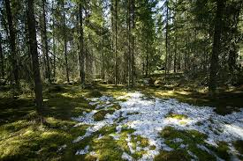
Finnish pine forest
Notes:
Japanese horseradish, wasabi.
The wasabi plant is the diva of plants. It needs good sunlight, but it needs shade. It needs lots and lots of cold water, but not that cold. Not too hot either. Actually, just make sure it’s 13-18 degrees celsius, otherwise it’ll die. And it needs to be fresh, flowing, natural spring water. Or it’ll die. And if your wasabi plant dies, you’ve wasted one year and three months of your life — because that’s how long they take to grow.

Slide 8
Wound healing
Fibrosis
Cardiovascular diseases
Diabetes
Neurodegenerative Diseases
Aging
Autoimmune disorders
Chronic infections
Gut disorders
Cardiovascular diseases
Diabetes
Aging
nfections
Gut disorders
Conditions matter

Slide 9
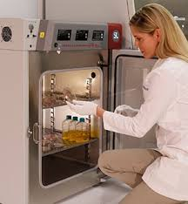
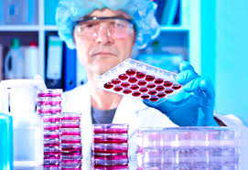
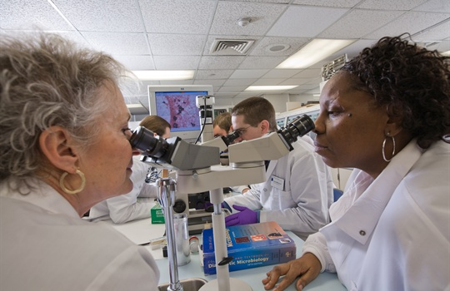
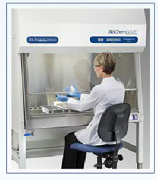
Current cell culturing often done on open bench

Slide 10
Current cell culturing often done on open bench
This is like growing wasabi in a Finnish pine forest

Slide 11
Cell culture on an open bench and in a CO₂ incubator
Cell culture currently controls:

Slide 12
Cell culture on an open bench and in a CO₂ incubator
Cell culture currently controls:
  temperature

Slide 13
Cell culture on an open bench and in a CO₂ incubator
Cell culture currently controls:
  temperature
  relative humidity

Slide 14
Cell culture on an open bench and in a CO₂ incubator
Cell culture currently controls:
  temperature
  relative humidity
  carbon dioxide

Slide 15
Cell culture on an open bench and in a CO₂ incubator
Cell culture currently controls:
  temperature
  relative humidity
  carbon dioxide
What about oxygen?

Slide 16
Mimicked cell physiology

Slide 17
Differential oxygen concentrations of the body
Atmospheric O₂ approx. 21%

Slide 18
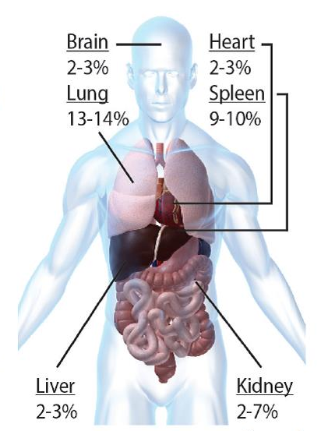
Differential oxygen concentrations of the body
Atmospheric O₂ approx. 21% (160mmHg)

Slide 19
Differential oxygen concentrations of the body
Atmospheric O₂ approx. 21% (160mmHg)
What does 21% O₂ mimick in an
experiment?

Slide 20
Why is oxygen so important??
Why is oxygen so important?
Why is oxygen so important?

Slide 21
Oxygen regulates intracellular processes
Oxygen is a universal electron acceptor
Hypoxia Response Pathways
  HIF, VHL, PHDs
Intracellular bioenergenics
  e.g. ATP production
Reactive Oxygen Species (ROS)

Slide 22
Oxygen regulates intracellular processes
Oxygen is a universal electron acceptor
Hypoxia Response Pathways
  HIF, VHL, PHDs
Intracellular bioenergenics
  e.g. ATP production
THESE CAN ONLY OCCUR CORRECTLY IN PHYSIOLOGICAL OXYGEN
Reactive Oxygen Species (ROS)

Slide 23
Oxygen regulates intracellular processes
Too little
- lack of energy production
- upregulation of glycolysis
- increased ventilation and cardiac output
- increased vascularization
- tumour growth and metastasis
- myocardial, cerebral ischemia
- aberrant ROS production
(increased in cancer cells at
mitochondrial complex III)

Slide 24
Oxygen regulates intracellular processes
Too much (ie 21%)
- increased ROS production
- cellular damage (lipid oxidation)
- enzyme inactivation
- protein and nucleic acid oxidation
- cell death

Slide 25
Oxygen regulates intracellular processes

Slide 26
Oxygen regulates intracellular processes
Magdalen Fellow Professor Sir Peter Ratcliffe has won the Massry Prize for his elucidation of cellular oxygen sensing pathways and the implications for medicine. Sir Peter is currently Director of the Target Discovery Institute, and a Member of the Ludwig Institute for Cancer Research. He is a Fellow of the Royal Society and the Academy of Medical Sciences and is an honorary member of the American Academy of Arts and Sciences. In the 2014 New Year’s Honours List, he was knighted for services to clinical medicine

Slide 27
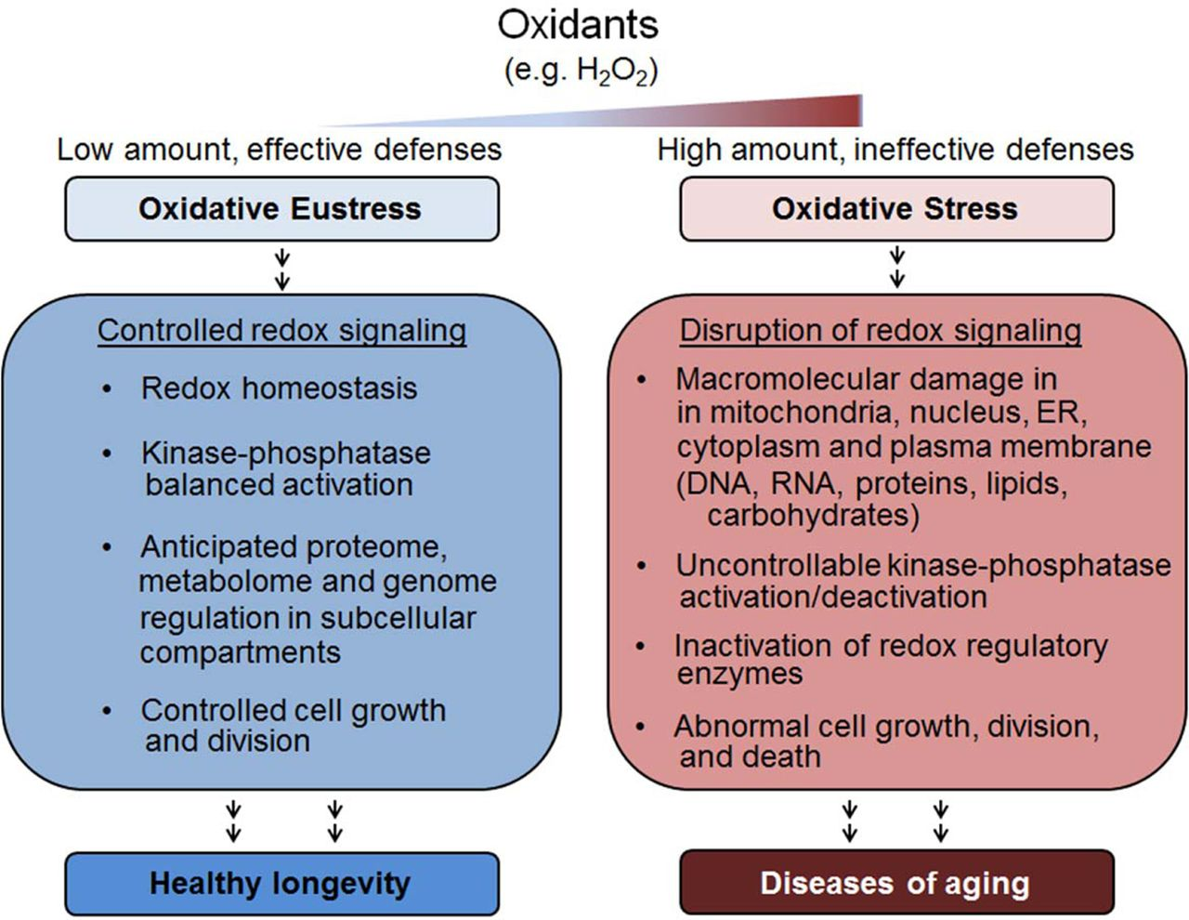
Consequences of altering O₂ levels

Slide 28
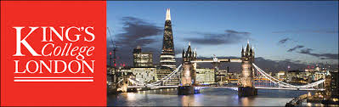
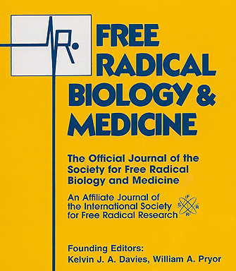
Prof. Giovanni Mann
Dr. Richard Siow
King’s College London

Slide 29


BMP2 repression and optimized culture conditions promote human bone marrow-derived mesenchymal stem cell isolation
Nicholas R. Forsyth, PhD
Keele University Medical School

Slide 30
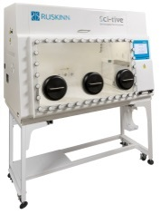
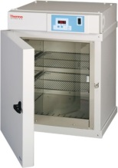
Physoxia significantly increases growth of Human Mesenchymal Stem Cells (hMSCs)
2% O₂ “ Physoxia”
* p=0.04
21% O₂ “Hyperoxia”
Kay et al., Regenerative Medicine, 2015

Slide 31
Physoxia on miRNA patterning
Agrawal et al., PLOS, 2016

Slide 32
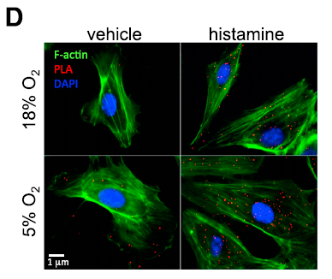
Functional changes in physoxia
Increase in colocalization of eNOS and PP2A-C in HUVECs upon histamine stimulation
Keeley et al., FASEB, 2017

Slide 33
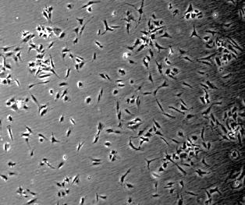
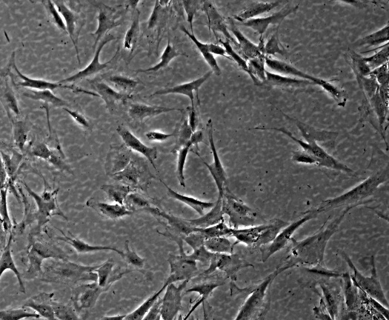
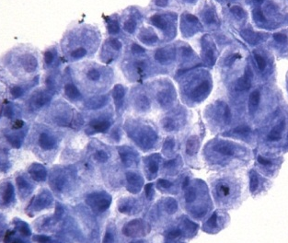
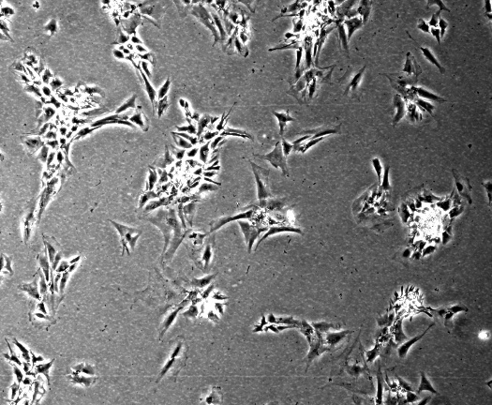
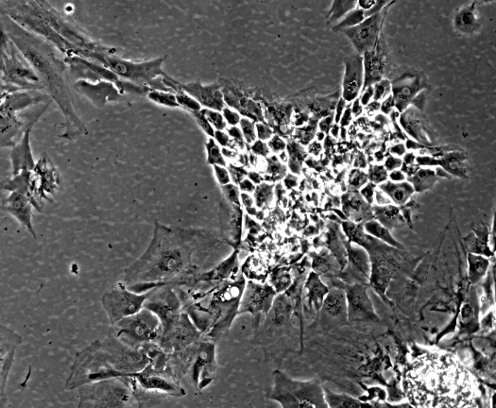
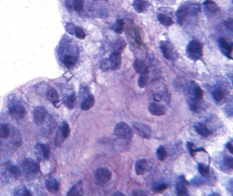
Physoxia affects cell morphology
Physoxia Normoxia
x4
x10
x4
x10
Mennan et al., 2016.
Notes:
chondrocytes

Slide 34
Open Bench Culture Scheme
Tri-gas incubators are better than nothing
Kay et al., Regenerative Medicine, 2015

Slide 35
Open Bench Culture Scheme
Cells isolated from ‘invivo’ source
Cells removed for analysis under a microscope in an open environment
Transferred to CO₂ or CO₂/O₂ incubator
Cells transferred to media (in a BSC)

Slide 36



Cells isolated from ‘invivo’ source
Cells transferred to media (in a BSC)
Transferred to CO₂ or CO₂/O₂ incubator
Cells removed for analysis under a microscope in an open environment
Notes:
chondrocytes

Slide 37
Cells respond quickly…
Measurable changes in cytosolic oxygen concentration within 3 minutes
Chapple et al., FRBM, 2016; Keeley T.

Slide 38
…but incubators can respond slowly
Full recovery to setpoint can take 20-30 minutes
Panasonic

Slide 39
Take Home Messages

Slide 40
Cells never see 21% O₂

Slide 41
Cells never see 21% O₂
_{21% O2 is HYPEROXIA}

Slide 42
_{USE PHYSIOLOGICALLY RELEVANT}
CONDITIONS FOR RELEVANT, TRANSLATABLE AND REPRODUCIBLE RESULTS

Slide 43
Phenotype
Migration
Protein
Gene expression
Signaling
…

Slide 44
Phenotype
Migration
Protein
Gene expression
Signaling
…
research

Slide 45
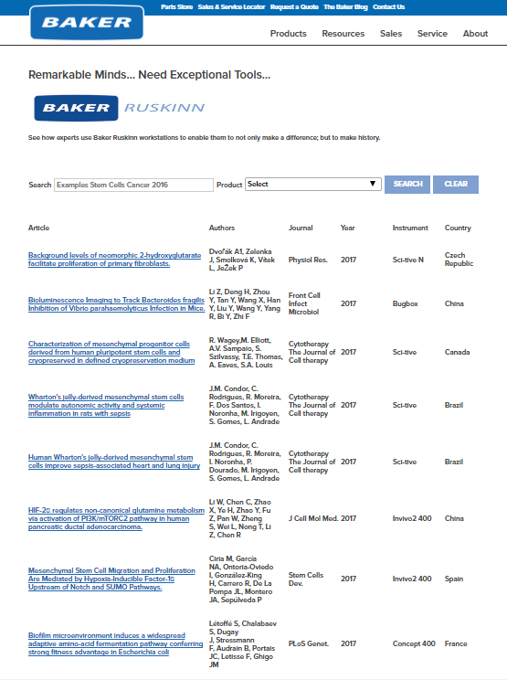
Scientific Publication Database of Ruskinn Users
1380 references and counting!
We provide Bibliography Help!

Slide 47
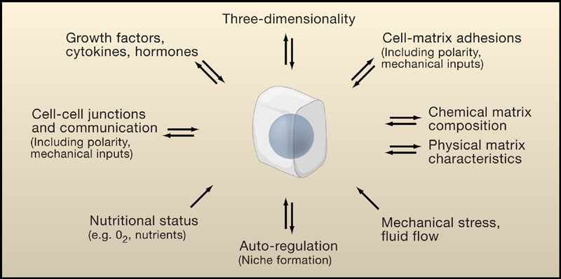
Mimicking in vivo Conditions
in Cell Culture: The Challenges
—
Ref: Cukerman 2007

Slide 48


Baker & Ruskinn
The Baker Company, based in Sanford, Maine, US
  Leaders in the air containment industry for over 60 years
  First Biological Safety Cabinet in 1948
Ruskinn Technology Ltd based in S.Wales, UK
  Leading supplier and manufacturer of innovative anoxic and hypoxic workstations
  First hypoxia workstation in 1999
New Product Development
  - Drawing on the strength of both organizations.

Slide 49
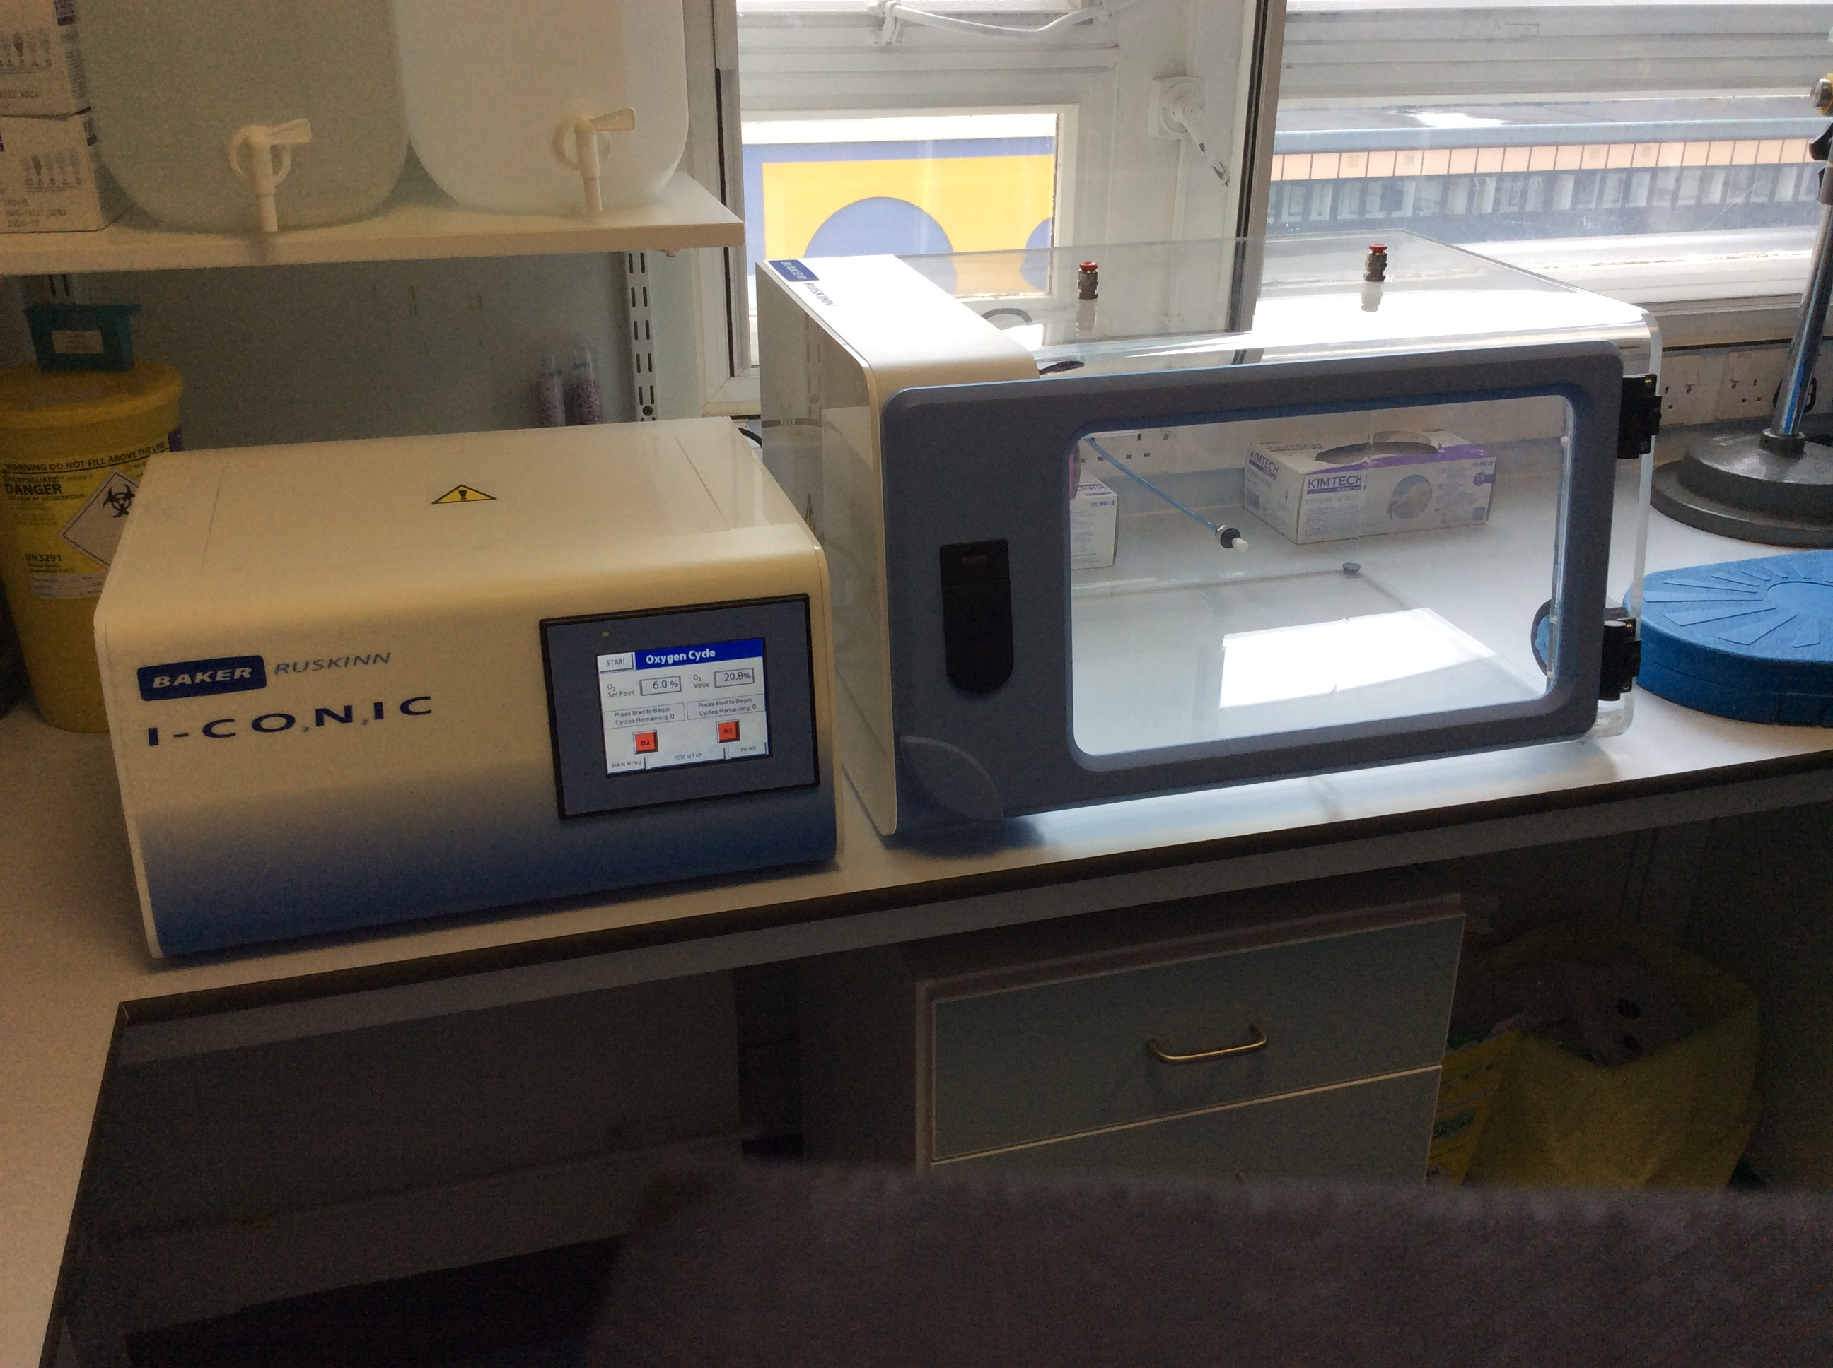
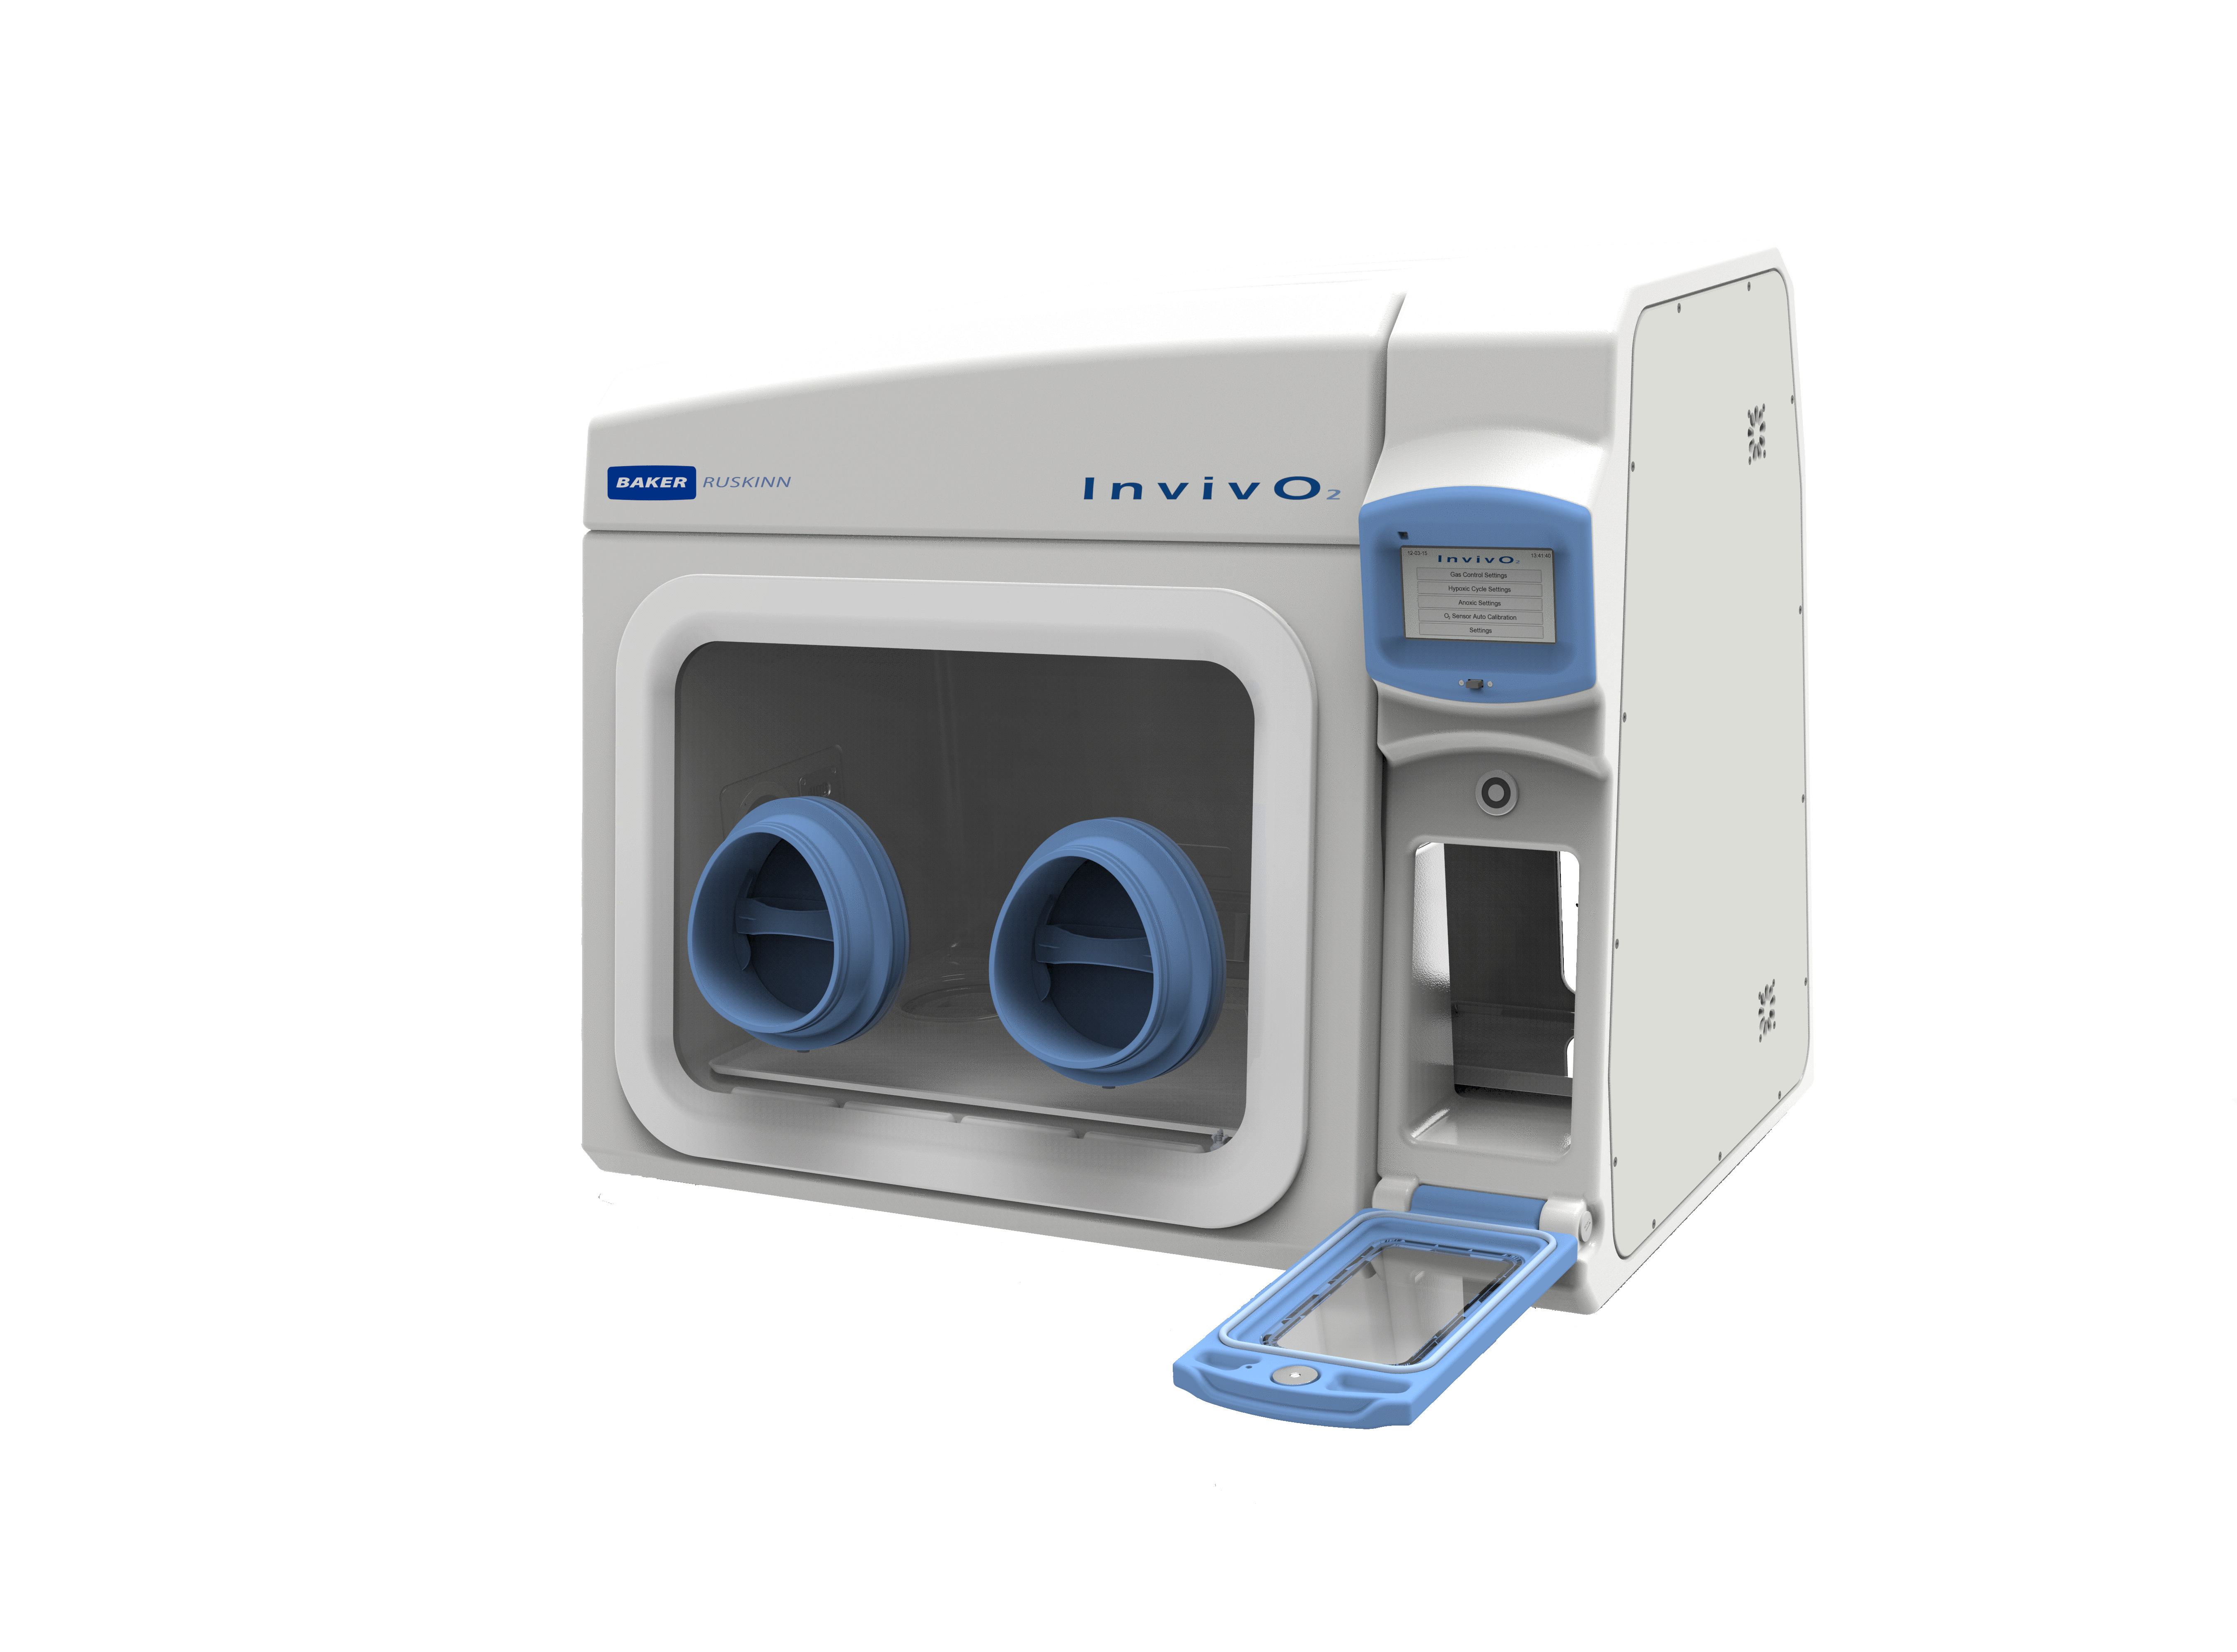
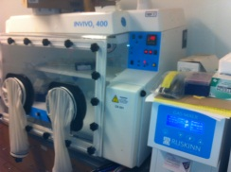
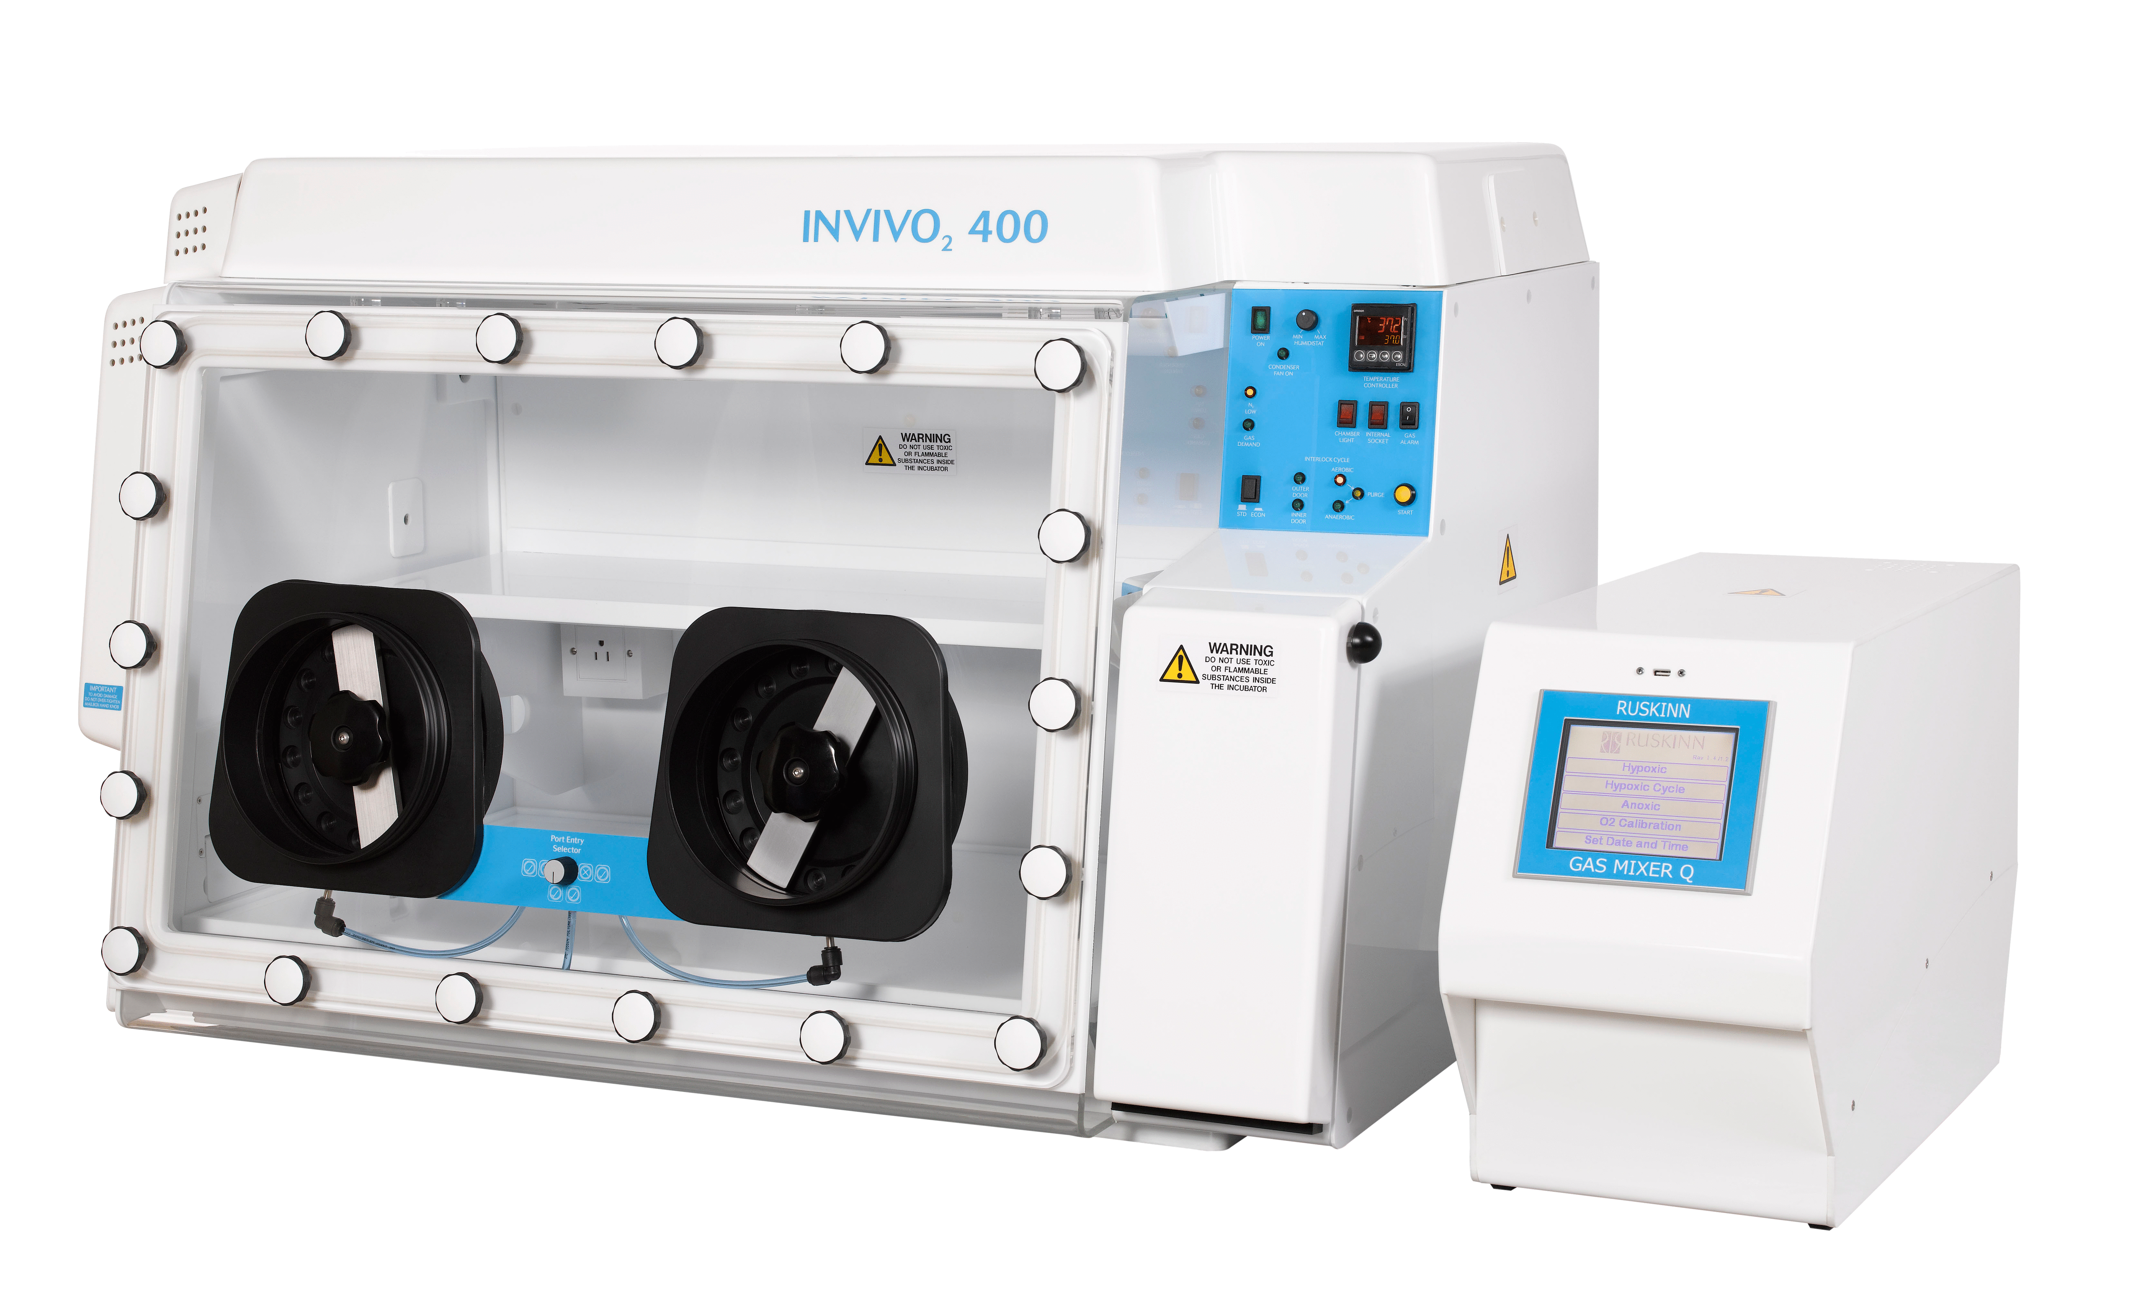
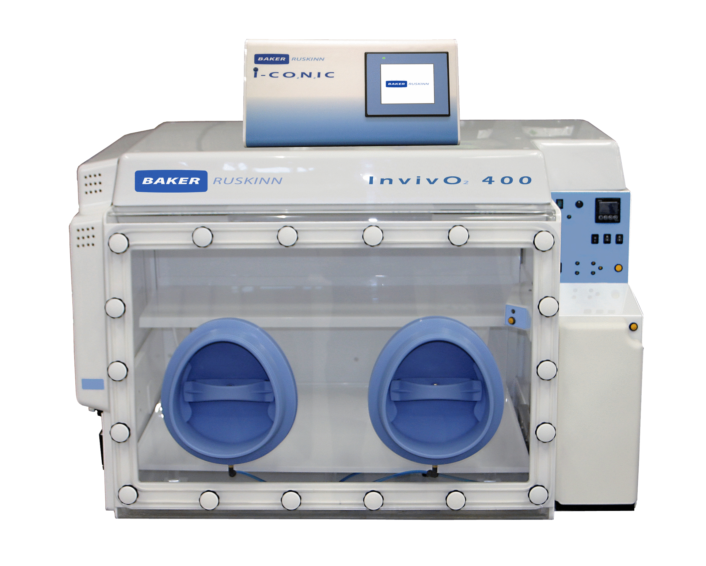
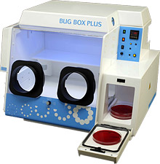
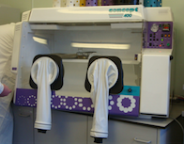

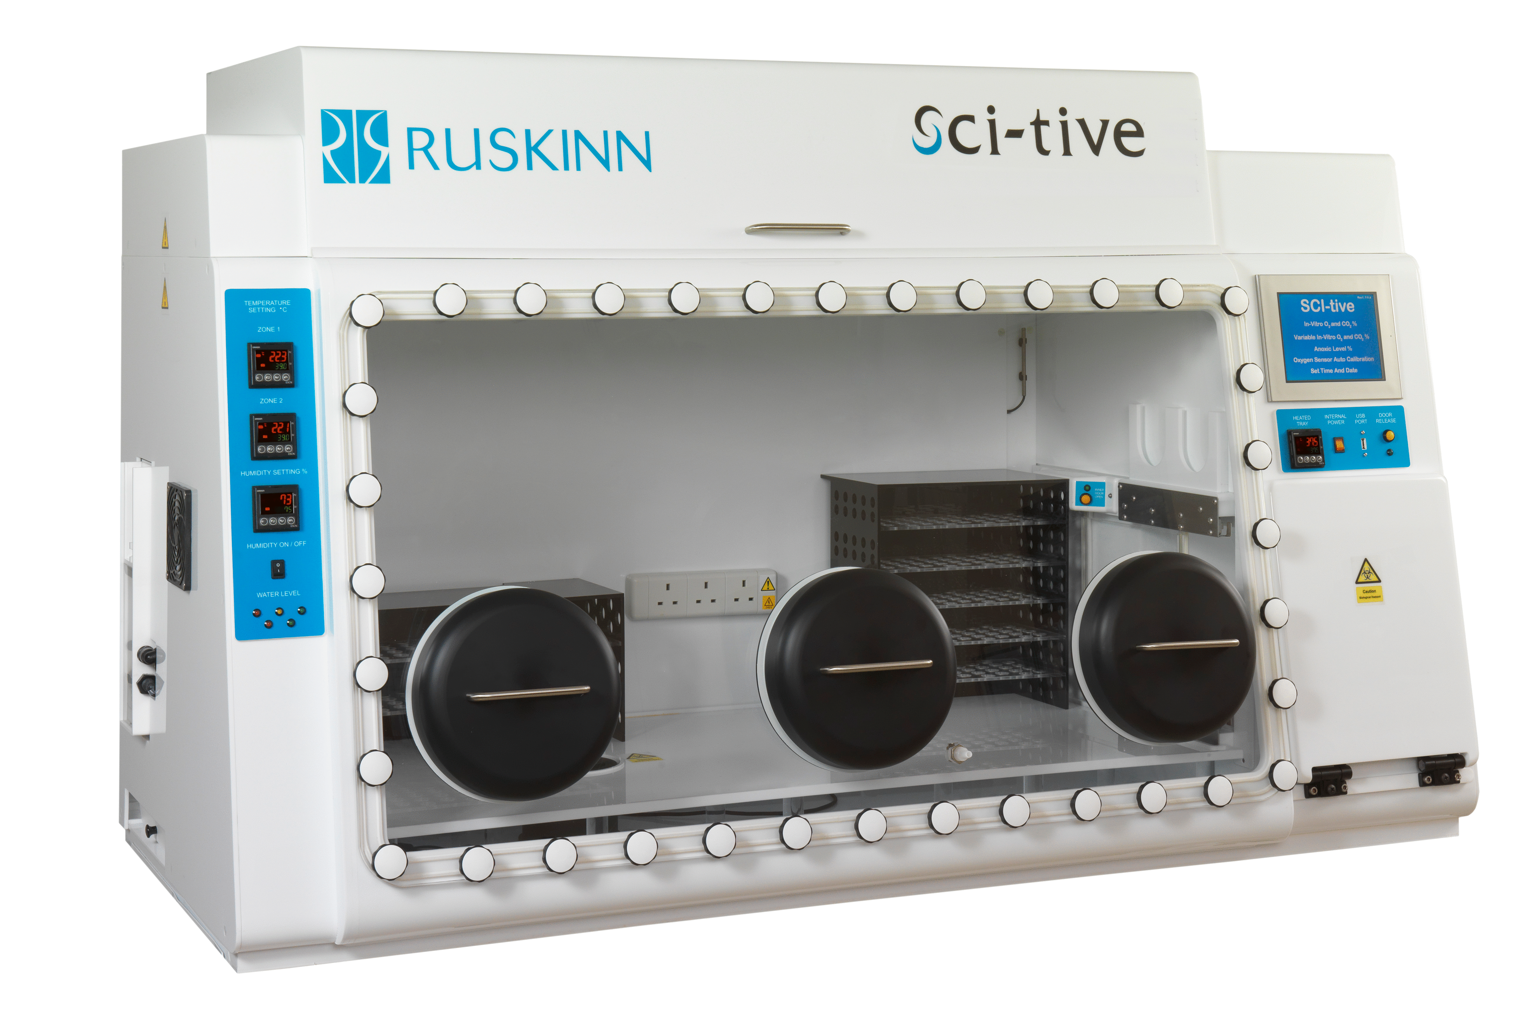
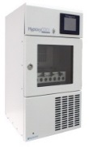
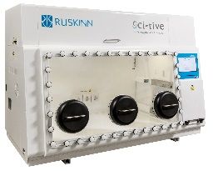
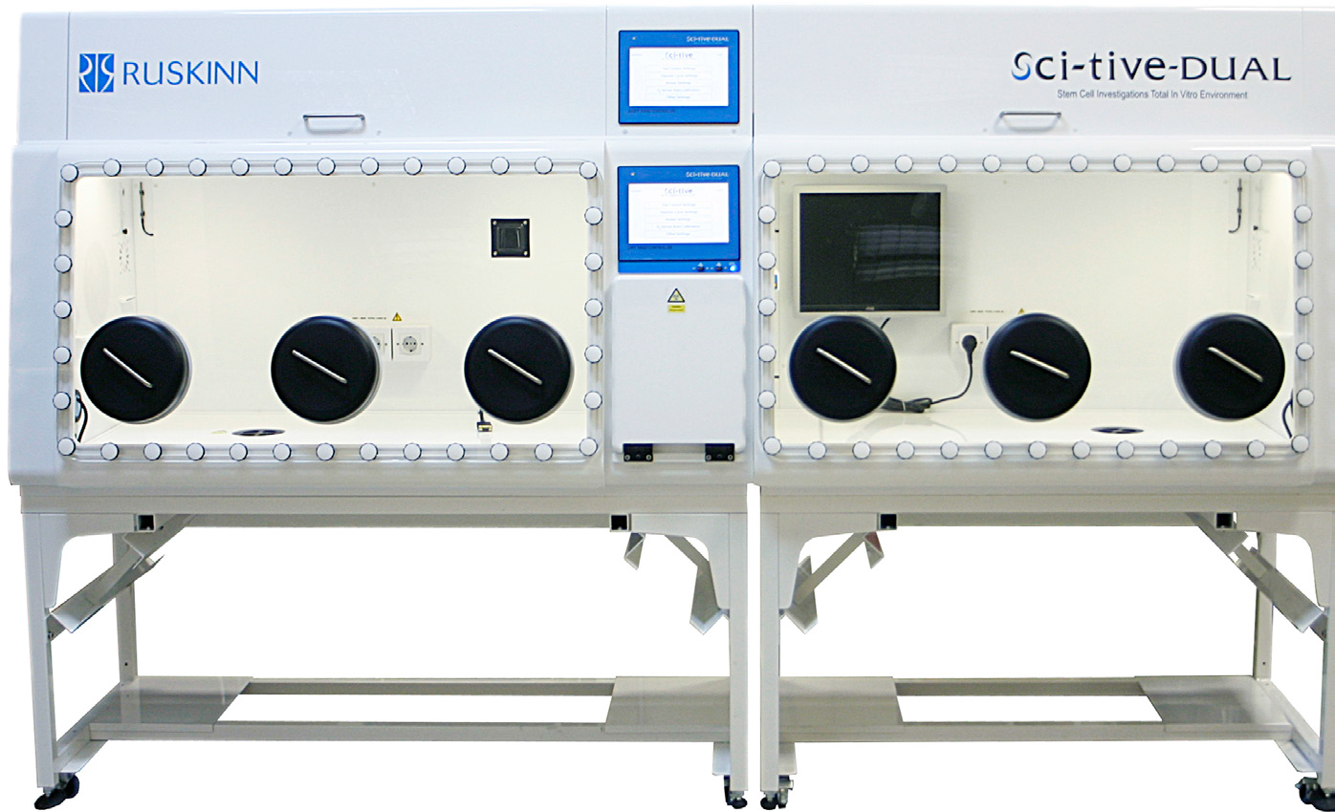
Baker Ruskinn - Key Milestones
Founded by
Andrew Skinn
2011 Acquired by
The Baker Company
VelO2x Animal Chamber
1999
Hypoxia
Workstation
InvivO2 working
with Peter Ratcliffe and Chris Pugh
2008
Gas Mixer Q for InvivO2
1993
2014 ICONIC
Gas Mixer/Ezeeyin
2016/7
New InvivO2 & New Concept
1994
Anaerobic
Workstations
Bugbox
Concept Gen 1
Concept Gen 2
2010 Stem Cell Workstations
“SCI-tive” range
2013 Media Pre-Conditioning
HypoxyCOOL
2013 SCI-tive Dual

Slide 50
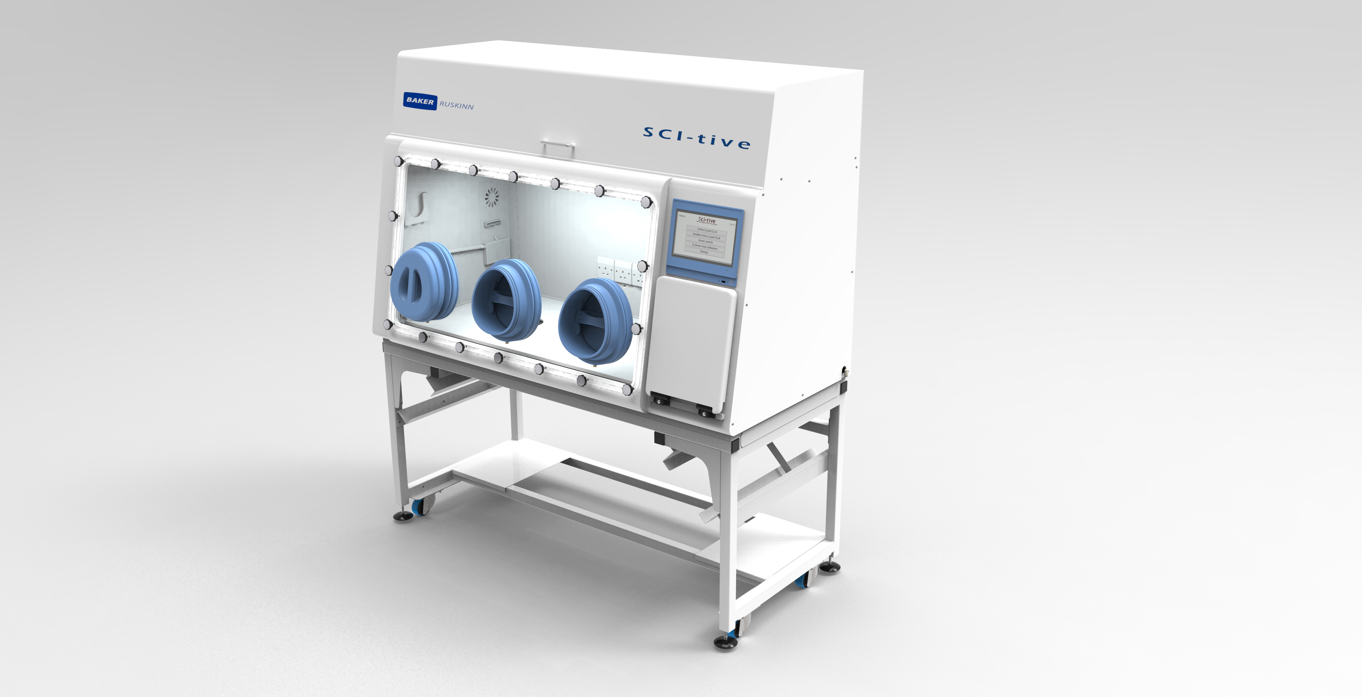
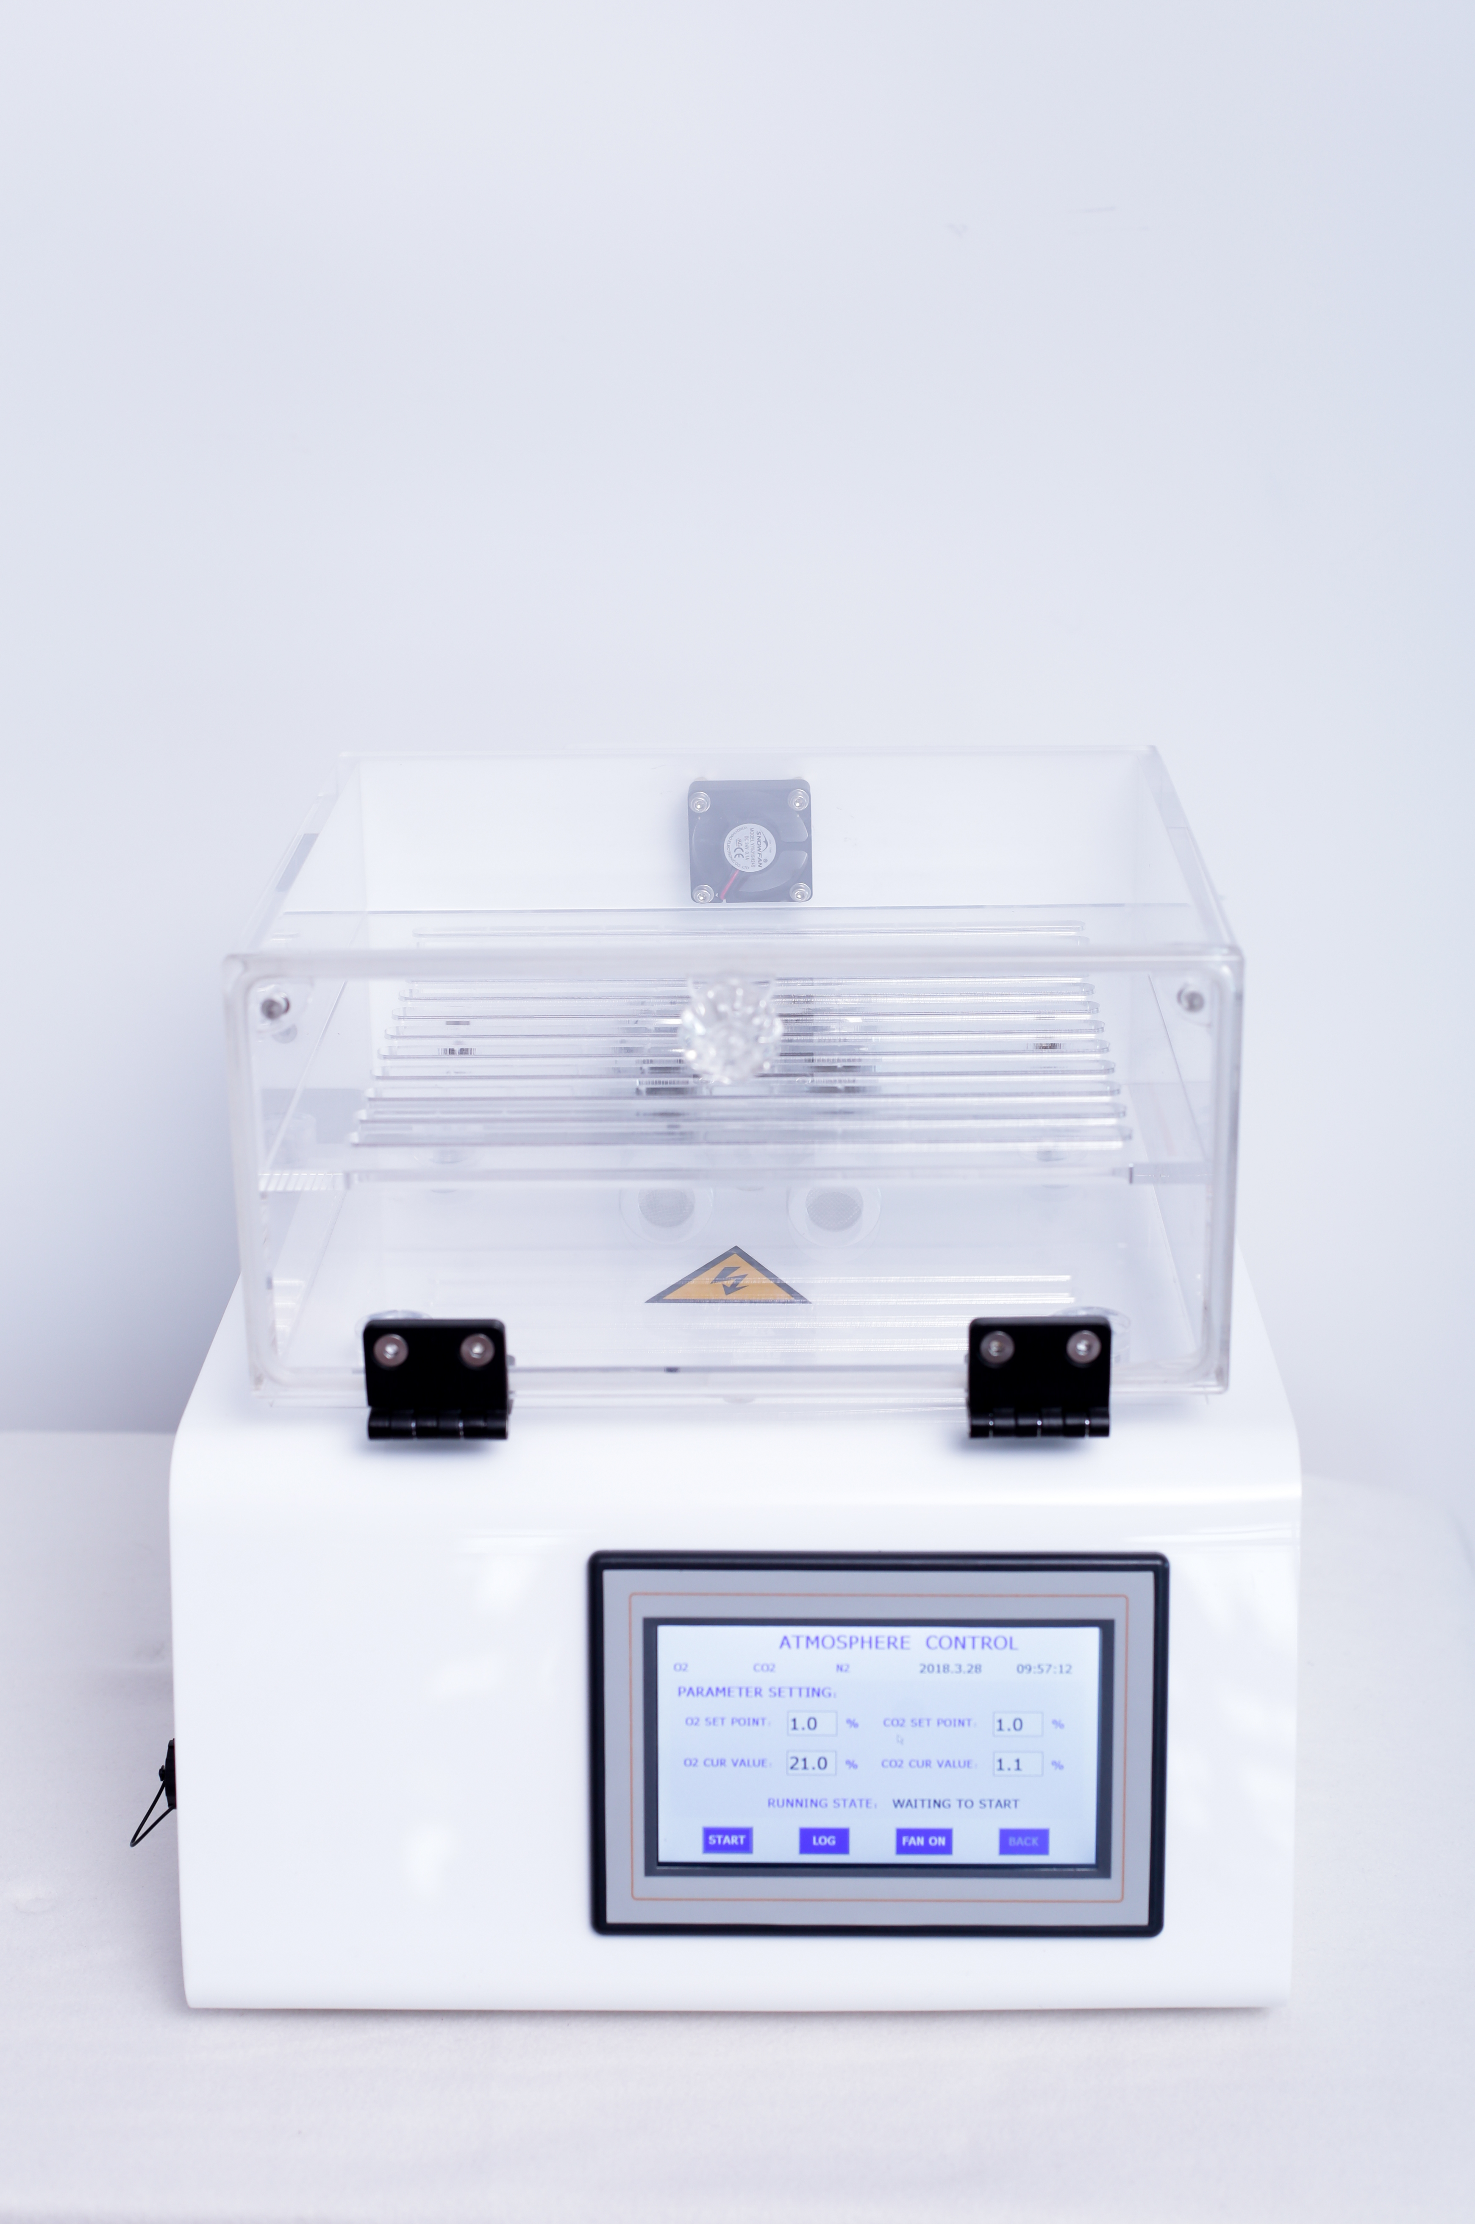
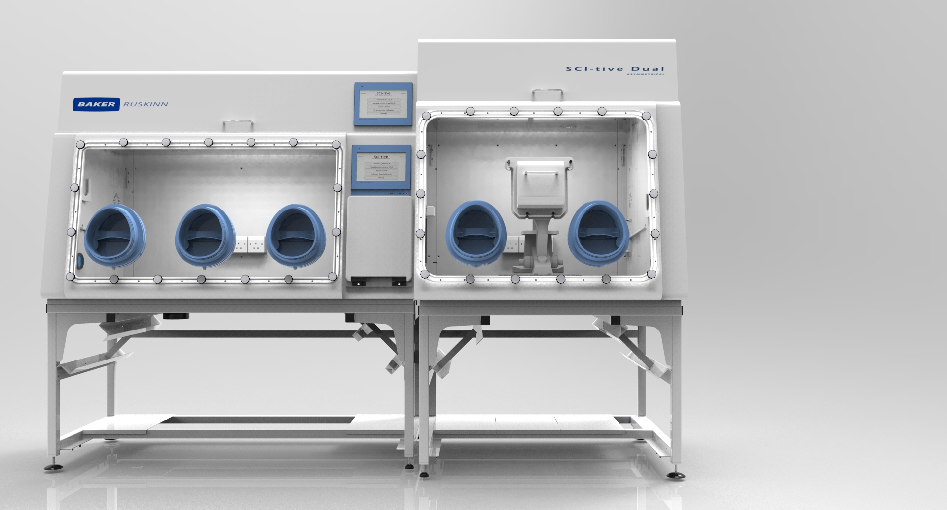
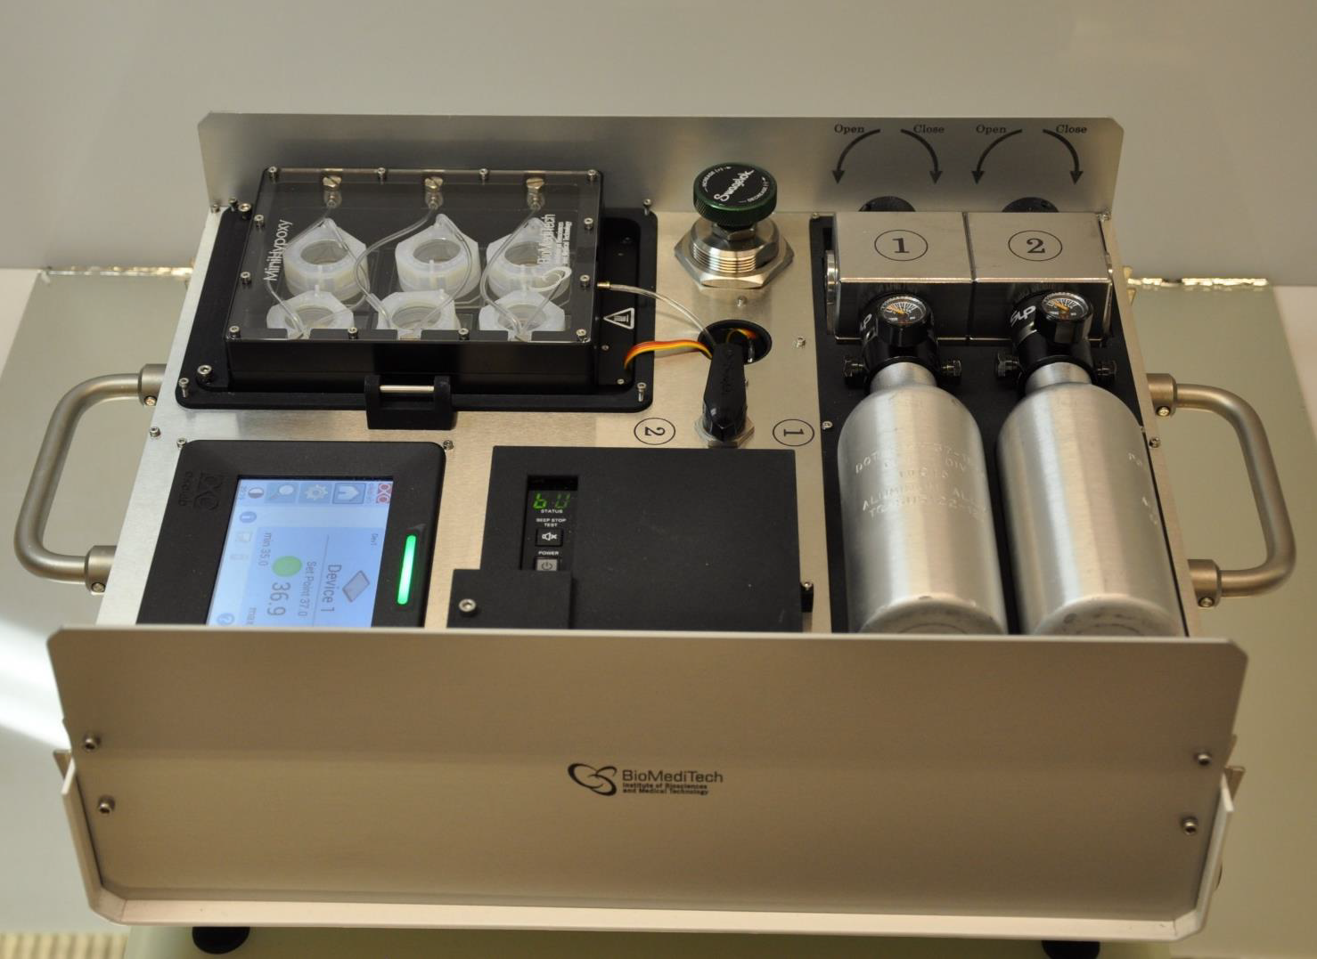
Baker Ruskinn-Key Milestones 2018
2018 Q1
2018 Q2
SCI-tive/SCI-tive Dual New Glove Ports/O2 sensor
CondoCell + ACU
PhO2x Box
OxyGenie

Slide 51
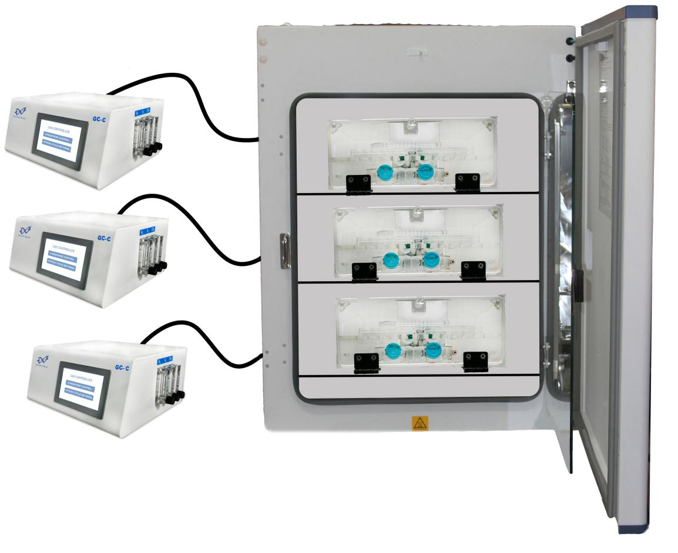
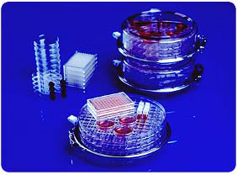
Physiological Oxygen Cell Culture:
Simple
—
Compact Static Chambers/Airtight Flush Boxes
without gas control
With gas control
Place chamber in incubator for temperature control

Slide 52
Physiological Oxygen Cell Culture: Standard
—
TRI-GAS (CO₂/O₂) Incubators
“Single Use”/”Short Term”
Continuous until door opens”

Slide 53

Physiological Oxygen Cell Culture:
STATE-OF-THE-ART
—
Continuous Physiological Oxygen
Incubated Workstations

Slide 54
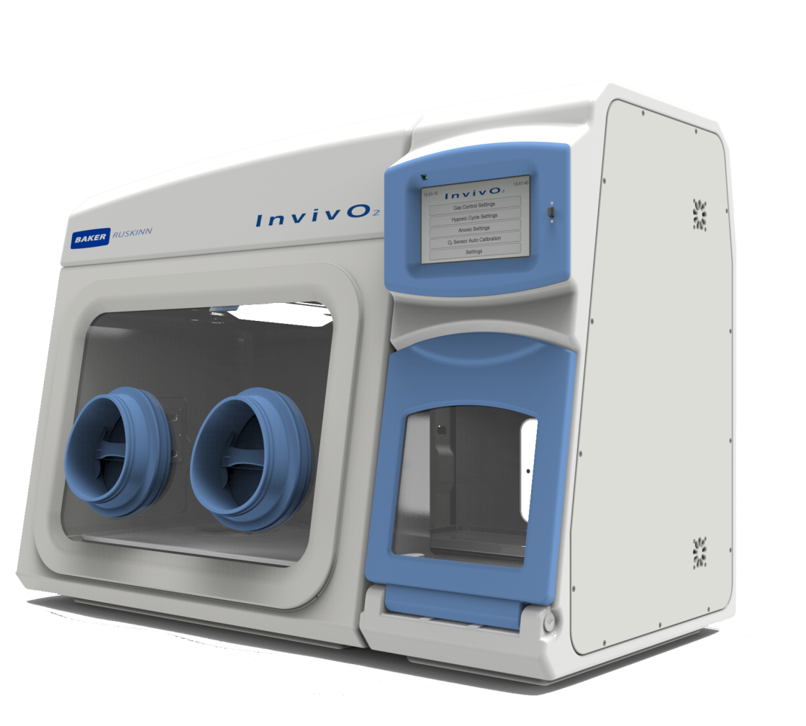
Continuous Physiological Oxygen Incubated Workstations
—
Combined Incubator & Workstation
Continuous Control of O₂, CO₂, Temperature, Humidity
Easy to use with Gloveless Direct Hand Entry
Customisable:-
  in vivo cell imaging
  in vivo cell based assays
  other

Slide 55
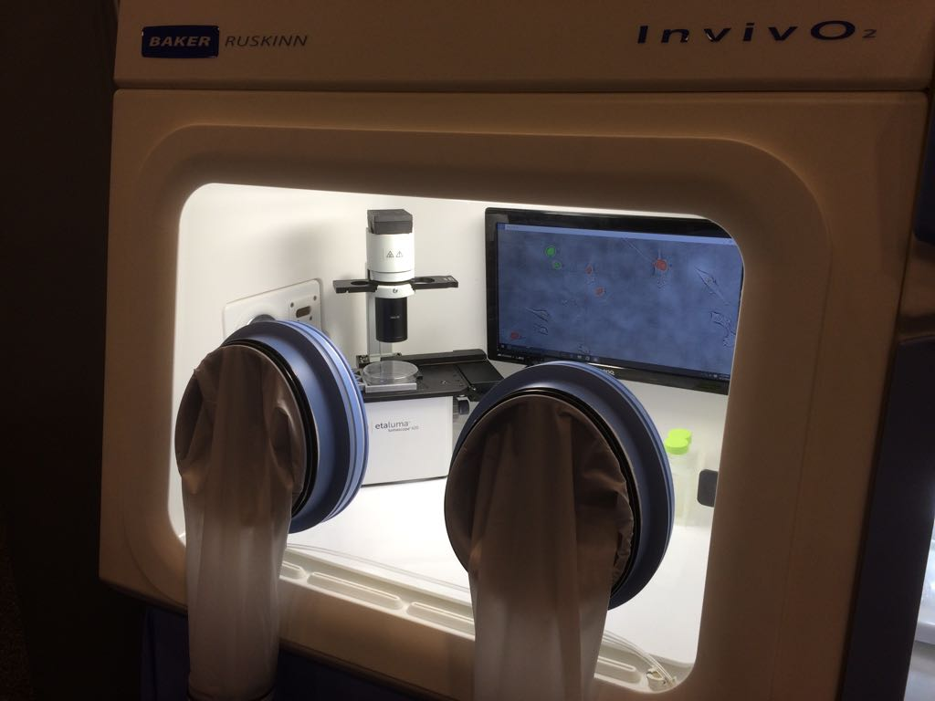
With Lumascope™ 620 Cell Imaging System
—

Slide 56
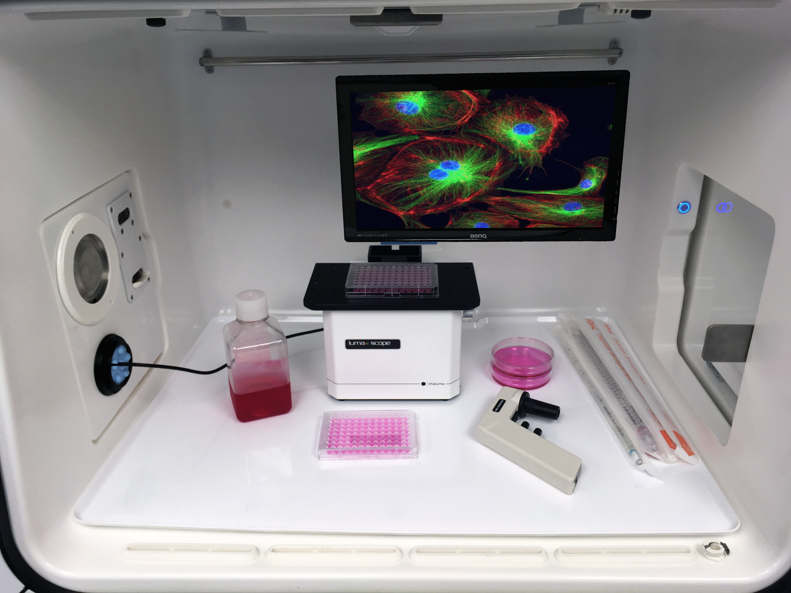
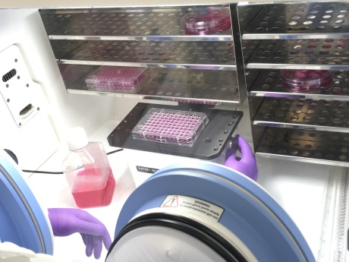
With Lumascope™ 620 Cell imaging System
—

Slide 57
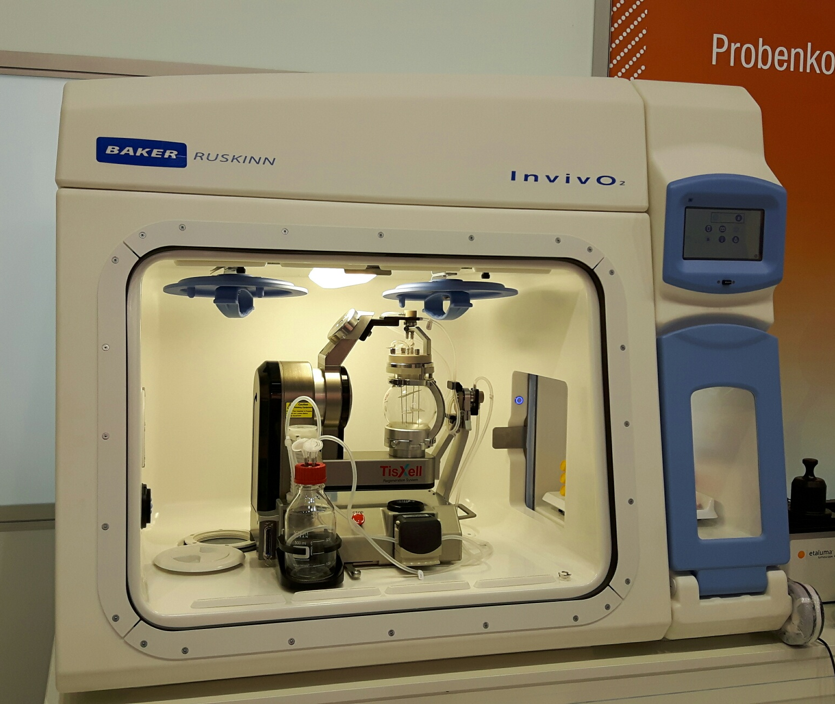
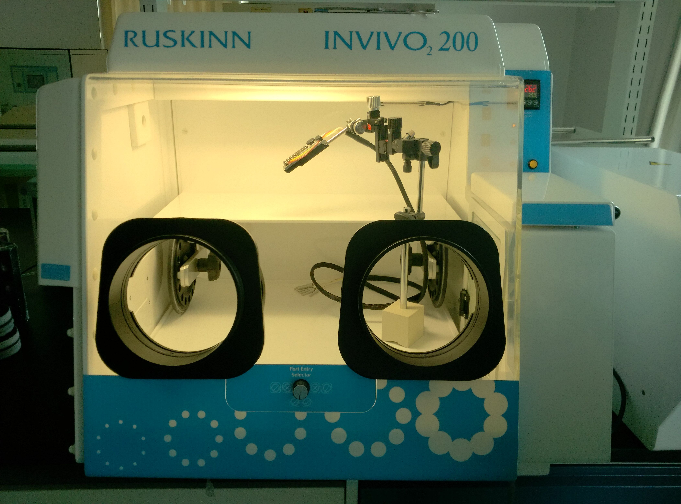
With 3D Cell Culture/Microfluidics
—
TisXell™ 3D system
Fluicell Biopen™ Microfluidic system

Slide 58
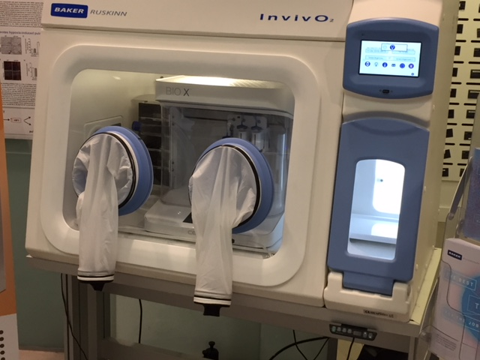
With 3D Cell Culture/Microfluidics
—
CellLink Bio X Bioprinter

Slide 59
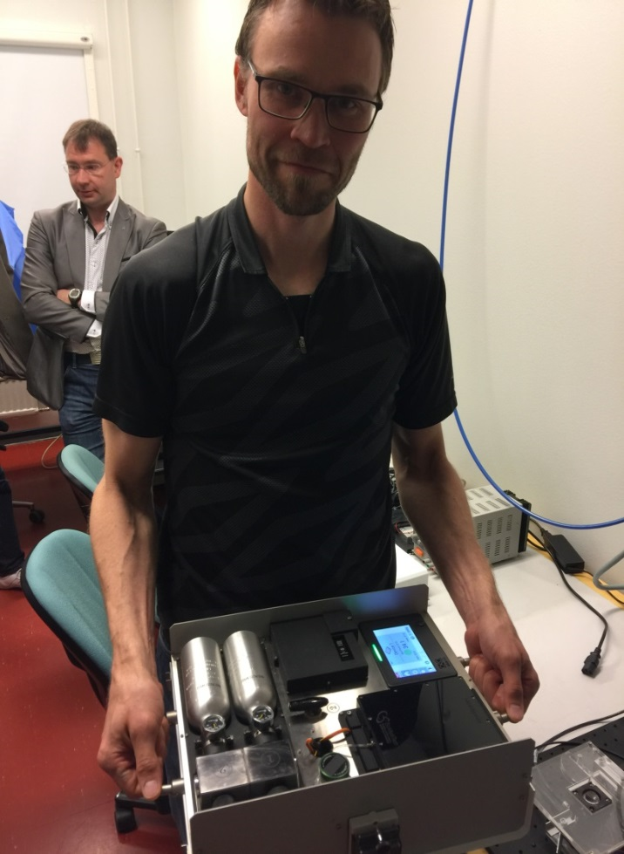
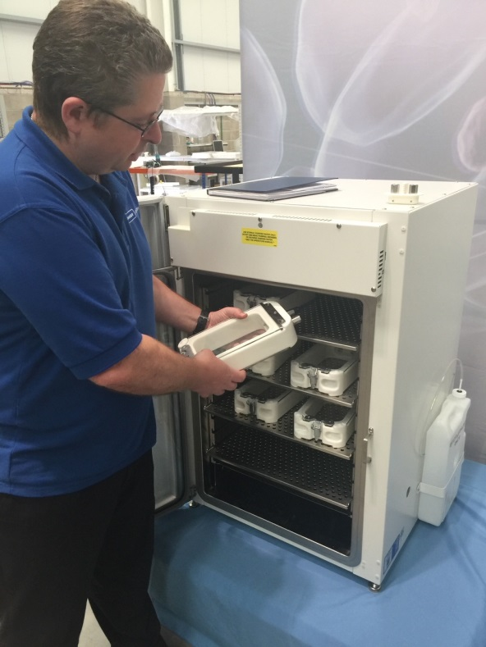
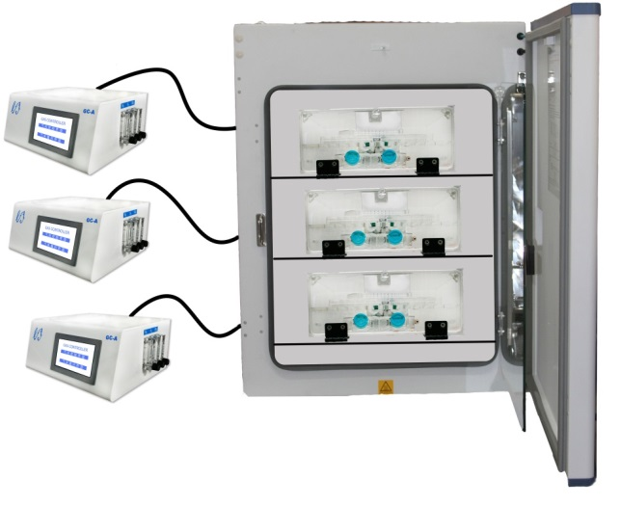
New generation of Low cost solutions all which mimic physiological oxygen
PhO₂x Box
CondoCell
OxyGenie

Slide 60
OxyGenie

Slide 61
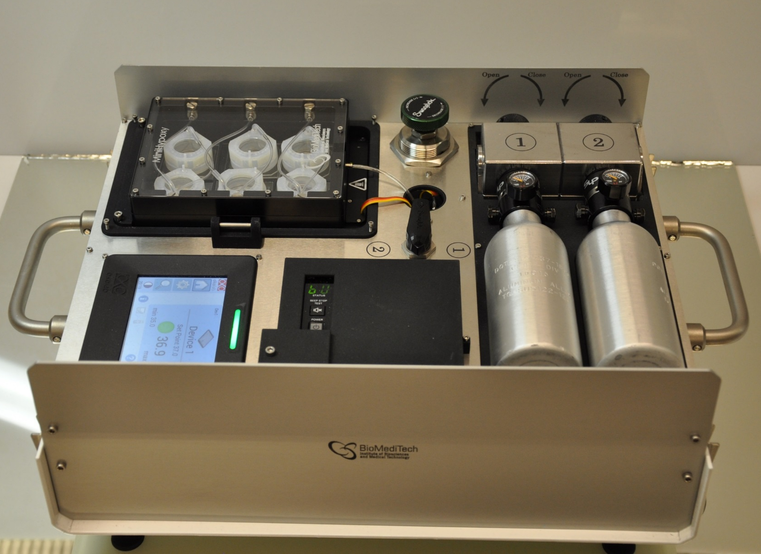
OxyGenie
precision and possibilities
Portable low oxygen environment device which can create and maintain
low oxygen levels in cell/tissue culture
Integrated heating element and CO₂ containing gas mixture
  pH and temperature constant
  Low media retention
  Stable environment
No additional equipment needed
to perform low oxygen studies!

Slide 62
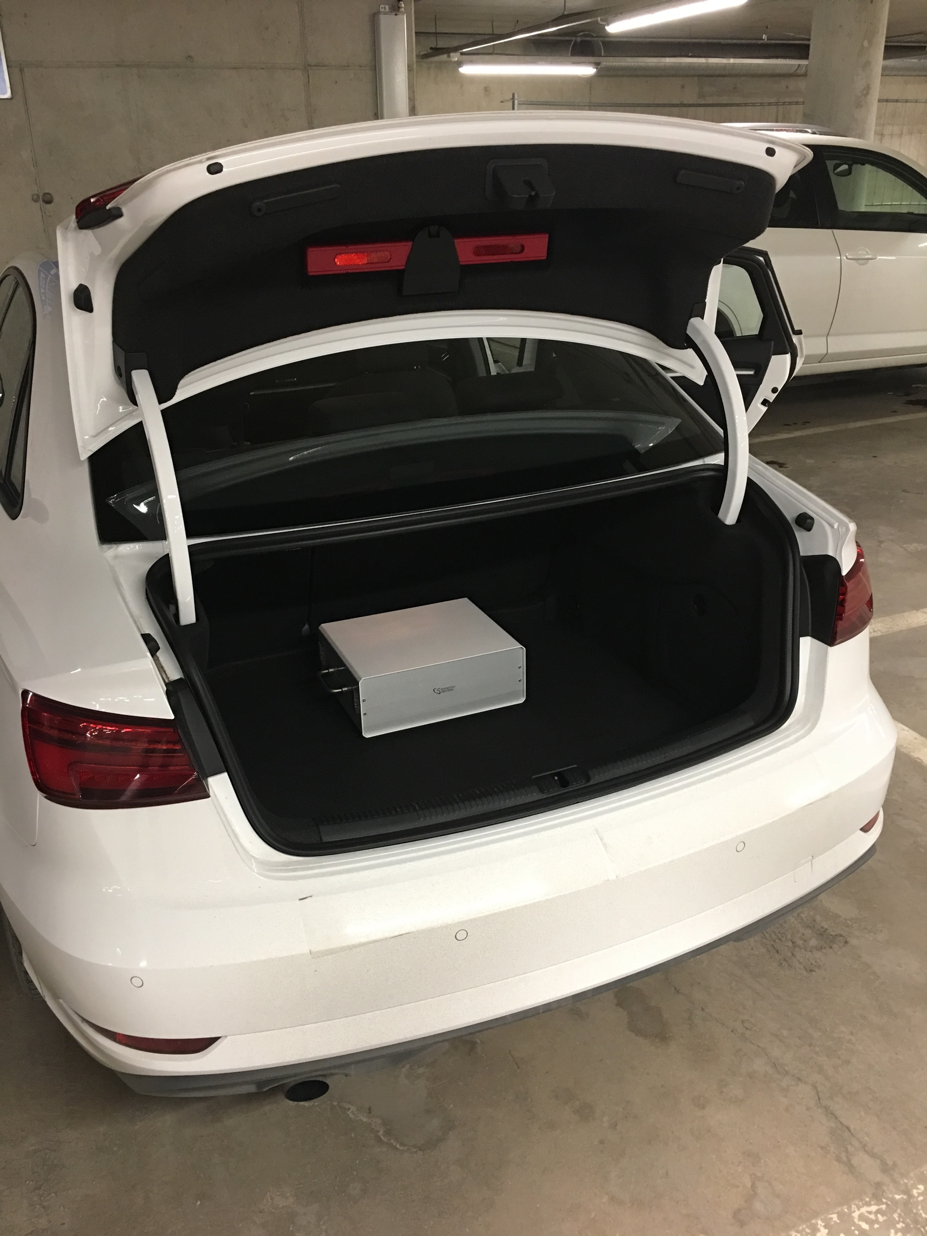
OxyGenie
OxyGenie
Portable device

Slide 63




OxyGenie
OxyGenie
Wide application area

Slide 64
OxyGenie
Low oxygen environment for all life science researchers
  Inexpensive
  Low running costs
  Easy to use ’kit-like’ structure
  Small bench size device
  Suitable for all fields of research and application areas
  → Translatable results!

Slide 65

OxyGenie
OxyGenie – possibilities
For several fields of research
  Cancer biology
  Stem cells
  Neurobiology
  Immunology
  Bone and connective tissue biology
  Cardiovascular research

Slide 66

OxyGenie
Standard protein/DNA/RNA expression studies
Imaging, high resolution (100X)
Irradiation studies
Near patient testing (point-of-care)
Cell morphology studies
Studies with small animals (worms,
Drosophila)
Plant studies
Microbiological studies

Slide 67
CondoCell

Slide 68

Portable, stable environments
—
CondoCell allows users for the first time to take their perfect continuous physiological oxygen environment out of their workstation or tri-gas incubator.
Each CondoCell:
Retains set CO₂ and O₂ conditions determined by incubator or workstation for 30 mins
Retains ambient heat within 2˚C of desired temp for up to 20 minutes without an external heating source.
Retains humidity at set point for over an hour.
Glass top and bottom for up to 20X imaging without leaving its physiological ideal environment

Slide 69


CondoCell – Portable, stable snvironments
—
Dimensions:
65 x 150 x 278 mm
Each CondoCell can hold up to:
1x T75 flask
6x T25 flasks
3x Multiwell culture dishes
3x 10 cm dishes

Slide 70


CondoCell breathes the environment it is
placed into
—
Workstation at 1% O₂, 5% CO₂, 37˚C, 80% RH? So is CondoCell!
TriGas Incubator at 5% O₂, 5% CO₂, 37˚C? Condo too!

Slide 71

CondoCell - Portable Stable Environments
—
Stackable for easy storage and portability

Slide 72


How does the CondoCell breathe?
—
A separate Air Circulation Unit will push the incubator environment into up to 6 Condos

Slide 73

How does the CondoCell breathe?
—

Slide 74
CondoCell Benefits– “3 P’s”
—
Physiological
CondoCell maintains key environmental conditions your cells require for survival when threatened by ambient conditions from outside of the culture environment (e.g. incubator door openings)
Protection
Mitigate the risk of cross contamination between cultures and from room air particulates
Portable
Allows for limited transport to/from an incubator/workstation while maintaining the culture environment

Slide 75
PhO₂x Box

Slide 76
What does the PhO₂x Box do?
—
It offers a defined hypoxic or physoxic cell culture environment (but it is not incubated)
It is ideal for…
  Short term in vitro Cell Culture experiments
  Where no media changes are needed during the experiment
  Where Plates/small Flasks are used.

Slide 77
PhO₂x Box
—
The PhO₂x Box comprises an Intelligent Gas Mixer (offering control of O₂/CO₂) connected to a Cell Culture Chamber
The Cell Culture Chamber comes as small or large size

Slide 78


PhO₂x Box: Culture Chamber sizes:
—
Small
16L
24 x 96 well plates
Large
25L
36 x 96 well plates
160 mm
230 mm
300 mm
300 mm
340 mm
360 mm

Slide 79
PhO2x Box can easily be placed inside an Incubator or Workstation (One Gas Controller per Culture Chamber) to give you multiple atmospheres to work with!
—

Slide 81

OxyGenie - Take home message
Coach

Slide 82

OxyGenie - Take home message
Coach

Slide 83

OxyGenie - Take home message
Coach First class

Slide 84

OxyGenie - Take home message
Coach First Class

Slide 85

OxyGenie - Take home message
Coach PREMIUM ECONOMY First Class

Slide 86
OxyGenie - Take home message
Coach PREMIUM ECONOMY First Class

Slide 87

New Physoxia Concepts- How do they fit together (1)?

Slide 88

New Physoxia Concepts-How do they fit together (2)?
—

